Slide 1
UNIT-2
FUNCTIONS IN PHP

Slide 2
What is a Function in PHP
A Function in PHP is a reusable piece or block of code that performs a specific action.
It takes input from the user in the form of parameters, performs certain actions, and gives the output. Functions can either return values when called or can simply perform an operation without returning any value.

Slide 3
PHP User Defined Functions
Besides the built-in PHP functions, it is possible to create your own functions.
A function is a block of statements that can be used repeatedly in a program.
A function will not execute automatically when a page loads.
A function will be executed by a call to the function.

Slide 4
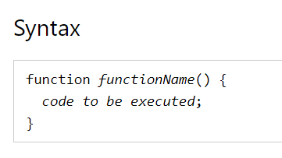
Create a User Defined Function in PHP
A user-defined function declaration starts with the word function:

Slide 5
Why use Functions?
Better code organization – PHP functions allow us to group blocks of related code that perform a specific task together.
Reusability – once defined, a function can be called by a number of scripts in our PHP files. This saves us time of reinventing the wheel when we want to perform some routine tasks such as connecting to the database
Easy maintenance- updates to the system only need to be made in one place.

Slide 6
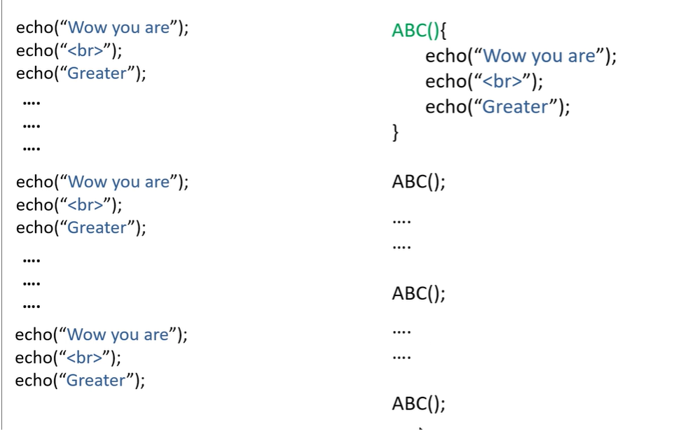

Slide 7
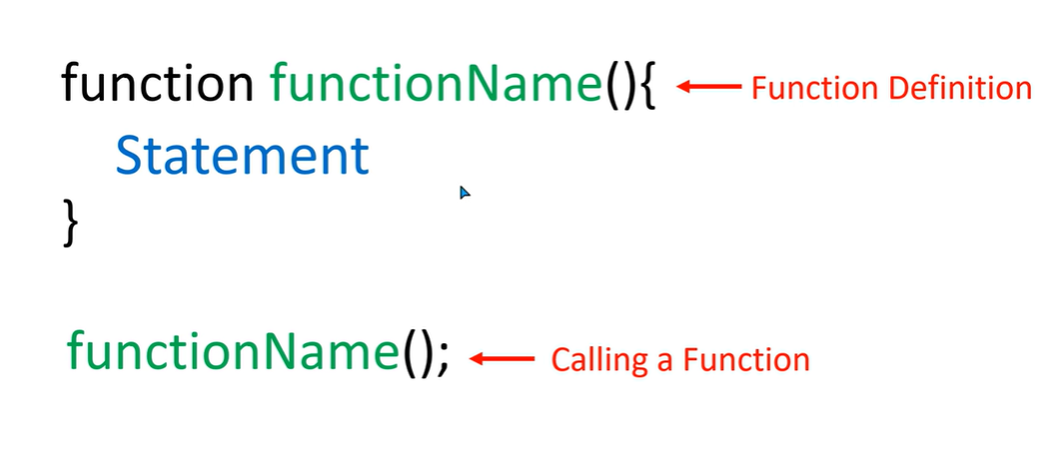

Slide 8
<?php>
function hello()
{
echo" hello everybody";
}
hello();
hello();
echo" hi hw r u";
hello();
?>

Slide 9
Advantage of PHP Functions
Code Reusability: PHP functions are defined only once and can be invoked many times, like in other programming languages.
Less Code: It saves a lot of code because you don't need to write the logic many times. By the use of function, you can write the logic only once and reuse it.
Easy to understand: PHP functions separate the programming logic. So it is easier to understand the flow of the application because every logic is divided in the form of functions.

Slide 10
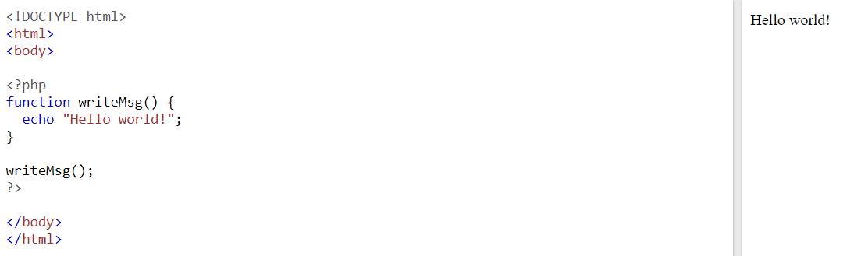

Slide 11
PHP Function Arguments
Information can be passed to functions through arguments. An argument is just like a variable.
Arguments are specified after the function name, inside the parentheses. You can add as many arguments as you want, just separate them with a comma.

Slide 12
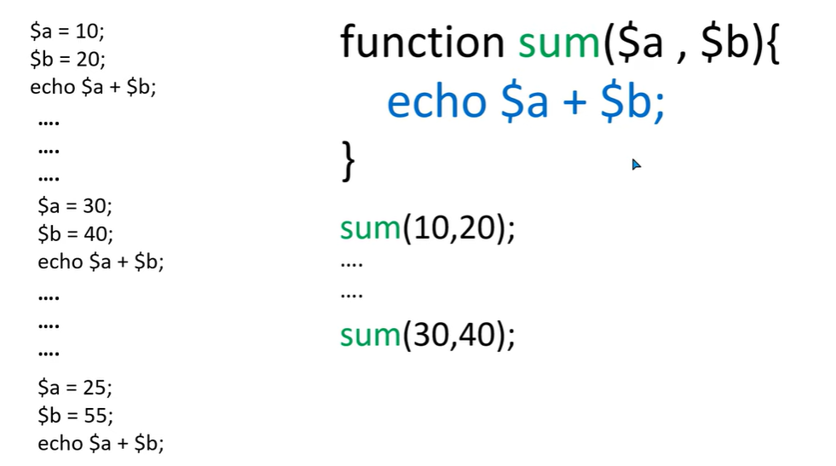

Slide 13
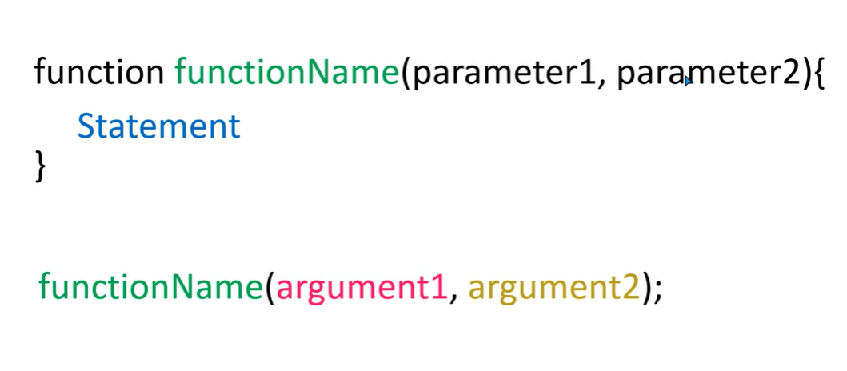

Slide 14
<?php
function hello($name,$lname)
{
echo"hello $name,$lname.<br>";
}
hello(“hai",“welcome");
hello(“hai","devi");
?>

Slide 15
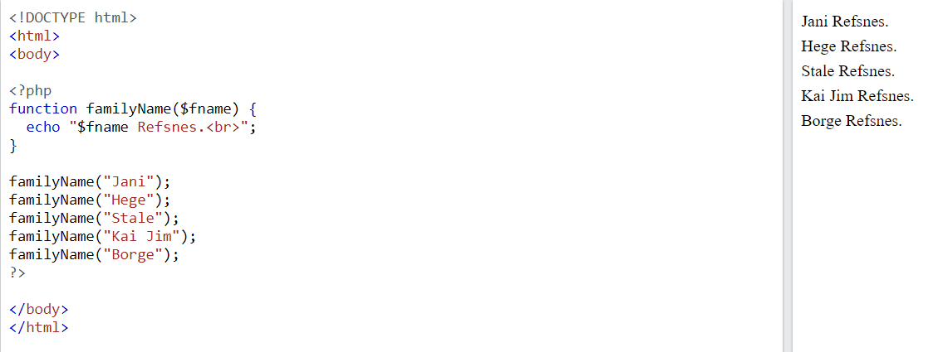

Slide 16

<!DOCTYPE html>
<html>
<body>
<?php
function familyName($fname, $year) {
echo "$fname Refsnes. Born in $year <br>";
}
familyName("Hege","1975");
familyName("Stale","1978");
familyName("Kai Jim","1983");
?>
</body>
</html>

Slide 17
PHP Default Argument Value
If we call the function setHeight() without arguments it takes the default value as argument:

Slide 18
<?php
function hello($name="first",$lname="last")
{
echo"hello $name,$lname.<br>";
}
hello("deepinder");
hello("renu",“dhiman");
?>

Slide 19
<?php
function hello($name="first",$lname="last")
{
echo"hello $name,$lname.<br>";
}
function sum($a,$b)
{
echo $a+$b;
}
hello("deep");
hello("renu","devi");
sum(10,20);
?>

Slide 20
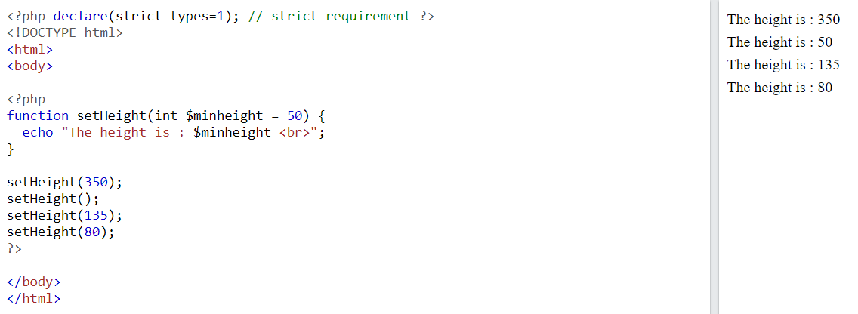

Slide 21
Parameter passing to Functions
PHP allows us two ways in which an argument can be passed into a function:
Pass by Value: On passing arguments using pass by value, the value of the argument gets changed within a function, but the original value outside the function remains unchanged. That means a duplicate of the original value is passed as an argument.
Pass by Reference: On passing arguments as pass by reference, the original value is passed. Therefore, the original value gets altered. In pass by reference we actually pass the address of the value, where it is stored using ampersand sign(&).

Slide 22
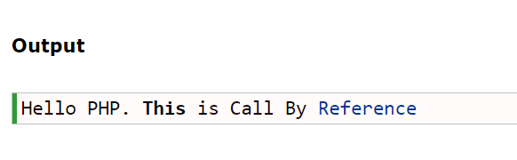
<!DOCTYPE html>
<html>
<body>
<?php function adder(&$x)
{
$x .= ' This is Call By Reference ';
}
$y = 'Hello PHP.';
adder($y); echo $y;
?>
</body>
</html>

Slide 23
<!DOCTYPE html>
<html>
<body>
<?php
function incre(&$i)
{
$i++;
}
$i = 1;
incre($i);
echo $i;
?>
</body>
</html>
OUTPUT
?

Slide 24
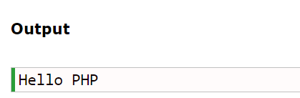
CALL BY VALUE
<!DOCTYPE html>
<html>
<body>
<?php function adder($x)
{
$x .= 'Call By Value';
}
$y = 'Hello PHP';
adder($y);
echo $y;
?>
</body>
</html>

Slide 25
<!DOCTYPE html>
<html>
<body>
<?php
function incre($i)
{
$i++;
}
$i = 1;
incre($i);
echo $i;
?>
</body>
</html>
OUTPUT
?

Slide 26
Return value
To let a function return a value, use the return statement:
<?php
function sum(int $x, int $y) {
$z = $x + $y;
return $z;
}
echo "5 + 10 = " . sum(5,10) . "<br>";
echo "7 + 13 = " . sum(7,13) . "<br>";
echo "2 + 4 = " . sum(2,4);
?>
<?php // strict requirement function addNumbers(float $a, float $b) : float { return $a + $b; } echo addNumbers(1.2, 5.2); ?>

Slide 27
<?php function recursion($a) { if ($a < 20) { echo "$a\n"; recursion($a + 1); } } ?>
All functions and classes in PHP have the global scope - they can be called outside a function even if they were defined inside and vice versa.
PHP does not support function overloading, nor is it possible to undefine or redefine previously-declared functions.

Slide 28
Dynamic Function Calls
<?php
function sayHello() {
echo "Hello<br />";
}
$function_holder = "sayHello";
$function_holder();
?>

Slide 29
PHP Variable Length Argument Function
PHP supports variable length argument function. It means you can pass 0, 1 or n number of arguments in function. To do so, you need to use 3 ellipses (dots) before the argument name.
The 3 dot concept is implemented for variable length argument since PHP 5.6.
Let's see a simple example of PHP variable length argument function.

Slide 30
<?php
function add(...$numbers) {
$sum = 0;
foreach ($numbers as $n) {
$sum += $n;
}
return $sum;
}
echo add(1, 2, 3, 4);
?>

Slide 31
Write a function to reverse a string.
Write a PHP function that checks whether a string is all lowercase.
Write a PHP function that checks whether a passed string is a palindrome or not?
PHP code to get number of days between two dates
Create a function for swapping of two numbers
Given an integer number and we have to find, print its reverse number using PHP.
PHP program to generate a random integer between the ranges
Write a program to show day of the week using switch

